Slide 1





Developer Personas
Findings & Analysis
Fall 2016
Core Coder
Cloud Architect
Data Connector
Quality Champion
Product Definer
Shortened URL for this deck:
sfdc.co/developers
Nov 10 presentation recording

Slide 2
Executive Summary

Slide 3
There are 5 types of developer users:
Core Coder
Cloud
Architect
Data Connector
Quality Champion
Product Definer

Slide 4
Each of the 5 Developer Personas focuses on a core set of job functions:
Primary job function (3+ hours per day)
Customizing Salesforce with code
Managing integrations
Technical architecture
Managing projects
Managing releases
Configuring data connections
Analyzing data
Testing and quality control
Gathering requirements
Writing documentation
Secondary job function (1-3 hours per day)
Core Coder
51%
Cloud Architect
13%
Data Connector
18%
Quality Champion
7%
Product Definer
11%

Slide 5
Key Findings
All 5 developer personas are found at companies of all sizes and types.
Few were previously Salesforce administrators – the jump from admin to developer is limited.
All the personas use declarative and programmatic tools.

Slide 6
How do we get more people building more apps on the Platform?
Notes:
How do we get more people building more apps on the Platform?

Slide 7
Let’s start by understanding who our users are and how they experience the Platform currently.
User personas help us do this.
Notes:
Let’s start by understanding who are users are and how they experience it currently.
User personas help us do this because they capture how people behave, their past experiences, goals and motivations.

Slide 8





Based on previous user research, we know that there are five Admin Personas:
Accidental Admins
Also Admins
Adept Admins
All-Star Admins
Accelerated Admins
Notes:
Based on previous user research, we know that there are 5 Admin Personas...
And we’ll come back to these later, but...

Slide 9
What about developers?
Notes:
What about developers?

Slide 10
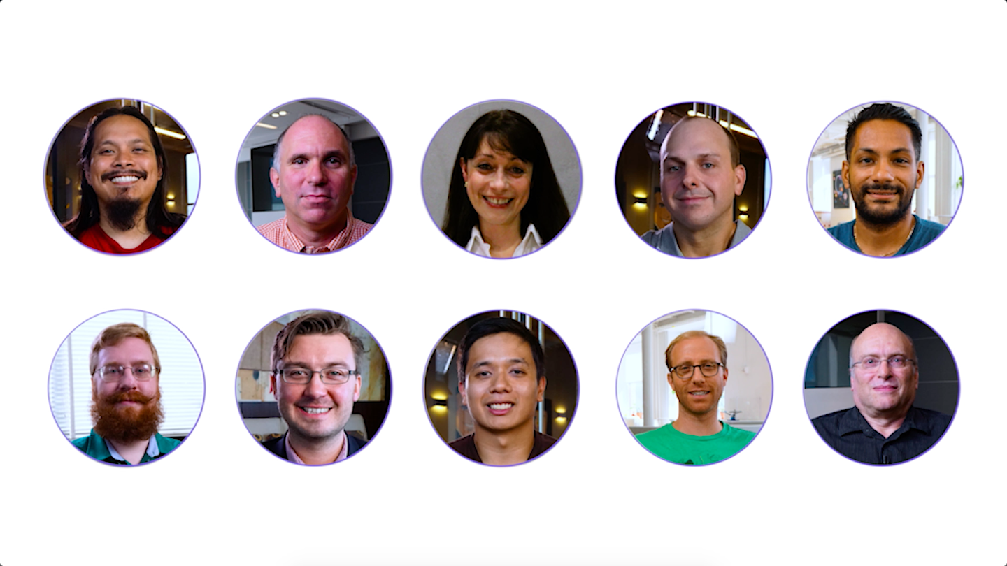
Meet our Developer Personas...
Notes:
Well let’s meet our Developer Personas now!
These personas were created from a survey we sent out to over 200,000 users and they are the result of an awesome collaborative effort across roles and teams, thank you to everyone who contributed to this project!

Slide 11
There are 5 types of developer users:
Core Coder
Cloud
Architect
Data Connector
Quality Champion
Product Definer
Notes:
As you can see from the highlight reel, our 5 developer personas are: Core Coder, Cloud Architect, Data Connector, Quality Champion, and Product Definer
We’ll dig into each of these personas in more detail in a second, but first let’s talk about how we got here.

Slide 12
Method

Slide 13
We sent a survey to over 200k users who customize and develop on the Salesforce Platform in May 2016*
8,838
surveys started
4.4% response rate
6,570
usable responses**
74% of surveys started
*Survey was distributed to everyone with a Developer Edition org and did not include Heroku users
**We excluded responses from users who did not complete our key behavioral questions
Notes:
We sent a survey out to over 200,000 users who customize and develop on the Salesforce Platform and the response was amazing. We had almost 9,000 surveys started and 74% of them or 6,570 were usable in the end. We’ve done these surveys in almost all the Clouds now and this has been the most engaged group by far. Shout out to Dev Marketing who helped us reach so many users.
---
We also received:
795 surveys from Salesforce employees
661 surveys from students

Slide 14
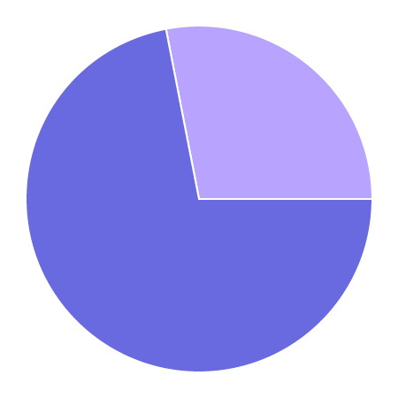
Both developers and admins completed the survey...
28%
Admins*
(Adept, All-Star, Accelerated)
72%
Developers
What are your responsibilities as a Salesforce developer? n = 6570
*As determined by reported behavior
Learn more about our Admin Personas here
Notes:
Both admins and developers completed the survey...
(4740 developers)

Slide 15
We’re going to focus on the developers.
72%
Developers
What are your responsibilities as a Salesforce developer? n = 6570
Notes:
But today we’re going to focus on the developers.

Slide 16
We asked participants about how much time they spend on 12 customization and development functions in an average day.*
Salesforce administrative tasks |  | Managing releases
Declarative, point-and-click customization of Salesforce |  | Configuring data connections
Customizing Salesforce with code |  | Analyzing data
Managing integrations |  | Testing and quality control
Technical architecture |  | Gathering requirements
Managing projects |  | Writing documentation
*Response options for time: a) less than 1 hour, b) 1-3 hours, c) more than 3 hours
Notes:
The key survey question we used to segment the developers was this one here - how much time do they spend on these 12 customization and development functions.
Everyone thinks they do all-the-things but most of the time they actually don’t.

Slide 17
We ran a factor analysis on this reported behavior data to understand which development tasks tend to occur together...
Notes:
We ran a factor analysis on this responses to this question to understand which development tasks tend to occur together and to not occur together.

Slide 18
This analysis yielded five clear user types: our Developer User Personas.
Notes:
And this analysis showed 5 clear user types - our Developer Personas

Slide 19
Personas

Slide 20
There are 5 types of developer users:
Core Coder
n = 1828 (51%)
Cloud
Architect
n = 473 (13%)
Data Connector
n = 666 (18%)
Quality Champion
n = 251 (7%)
Product Definer
n = 393 (11%)
Notes:
The 5 developer personas are: Core Coder, Cloud Architect, Data Connector, Quality Champion, and Product Definer

Slide 21
Each persona focuses on a core set of job functions:
Primary job function (3+ hours per day)
Customizing Salesforce with code
Managing integrations
Technical architecture
Managing projects
Managing releases
Configuring data connections
Analyzing data
Testing and quality control
Gathering requirements
Writing documentation
Secondary job function (1-3 hours per day)
Core Coder
51%
n=1828
Cloud Architect
13%
n=473
Data Connector
18%
n=666
Quality Champion
7%
n=251
Product Definer
11%
n=393
Notes:
Each of those personas focuses on a different set of core job functions from that key survey question we looked at earlier - so for example, Core Coders spend 3+ hrs/day customizing Salesforce with code and 1-3 hrs/day managing integrations.

Slide 22
Let’s get to know them.
Notes:
Let’s get to know the individual personas and then we’ll zoom out to some broader findings.

Slide 23
Core Coder
Customize Salesforce with code
Notes:
First we have Core Coders

Slide 24


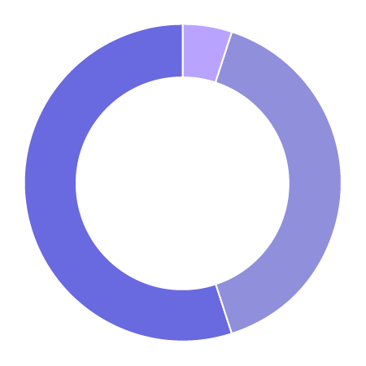





Core Coders spend 3+ hours per day customizing Salesforce with code and 1-3 hours managing integrations.
Development Style
Top Tools & Technologies
Core Coder
Mostly clicks
5%
50/50
40%
Custom objects
Apex & Visualforce
Formulas
Custom page layouts
HTML/CSS
Experience
Mostly code
55%
0-3 years
with Salesforce
0-3 years
with development in general
Previous Role
Salesforce Pros & Cons
+ Ease of learning & use
+ Customization & build possibilities
- Governor limits
- Debug & developer tools
Non-SFDC Dev
48%
Student
34%
Admin
13%
Salesforce Use
80-100%
of time spent on Salesforce development
Learning Strategy
Code Samples
Doc
Salesforce Dev Blog
Success Comm
Trailhead
Tutorials
Notes:
Core Coders’ primary function is customizing Salesforce with code, so they’re using Apex and Visualforce to build on the Platform and 55% develop mostly with code.
They are dedicated to developing on Salesforce and spend 80-100% of their time on it.
Almost half of Core Coders previously worked on other platforms and interestingly, only 13% of Core Coders were previously Salesforce admins.
This means that it’s not so much a journey from admin to developer, but rather platform to platform.

Slide 25


Pretty much anything you think of from a business perspective can be done on the Salesforce platform in one way or another, and I love the challenge of figuring out how to do that.
Dawn
Salesforce Engineer
The language is easy to learn. I was a web application programmer using C# and SQL server for 8 years. Switching to Salesforce development did not require much effort.
Shishir
Technical Consultant
Notes:
Shishir is a great example of this - he used to be a web application programmer using C# and SQL server, so switching to Salesforce wasn’t hard for him.

Slide 26
Pretty much anything you think of from a business perspective can be done on the Salesforce platform in one way or another, and I love the challenge of figuring out how to do that.
Dawn
Salesforce Engineer
The language is easy to learn. I was a web application programmer using C# and SQL server for 8 years. Switching to Salesforce development did not require much effort.
Shishir
Technical Consultant
Notes:
Shishir is a great example of this - he used to be a web application programmer using C# and SQL server, so switching to Salesforce wasn’t hard for him.

Slide 27

DEVELOPER CONSOLE. Testing is incredibly frustrating on developer console. I am constantly getting false feedback or it is crashing on me. Developer Console is a huge pain point!
Sita
Salesforce Developer
Notes:
While learning the Apex, Visualforce, and the Platform in general isn’t very difficult for Core Coders, they do see room for improvement with our developer tools and get frustrated with them like Sita talks about here.

Slide 28


Meet some Core Coders...
Matt
Illinois Institute of Technology
Victor
Appiphony
Notes:
To learn more about Core Coders from some Core Coders themselves, check out these video interviews we filmed at companies across the US.
(Matt is really great)

Slide 29

Meet some Core Coders...
Joe
Silverline

Slide 30
Core Coders are dedicated to building on the Salesforce Platform – and are looking for an improved set of tools to do so.
Notes:
In sum, Core Coders are dedicated to building on the Salesforce Platform and are looking for a better set of tools to do so.

Slide 31
Cloud Architect
Technical architecture and project management
Notes:
Up next are Cloud Architects

Slide 32
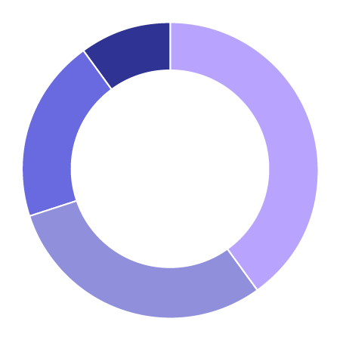
Cloud Architects spend 3+ hours per day on technical architecture and project management, and 1-3 hours per day managing releases.
Development Style
Top Tools & Technologies
Cloud Architect
HTML/CSS
Custom objects
Javascript
Unit tests
Trad. prog. languages (Java, C#, C/C++, etc.)
Other
10%
Mostly clicks
40%
Experience
Mostly code
20%
50/50
30%
0-3 years
with Salesforce
6+ years
with development in general
Previous Role
Salesforce Pros & Cons
+ Ease of use
+ Speed of development & delivery
- Developer tools
- More documentation & training
Non-SFDC Dev
43%
Proj Mgr
28%
Biz Analyst
17%
Salesforce Use
<10-100%
of time spent on Salesforce development
Learning Strategy
Code Samples
Doc
Salesforce Dev Blog
Success Comm
Trailhead
Tutorials
Notes:
Cloud Architects are focusing on technical architecture and project management. So they’re overseeing things and making sure that development projects are running smoothly including designing the overall system and resolving technical issues.
As you may have guessed, Cloud Architects are the most experienced Developer Persona and have 6+ years of experience with development in general.
In their previous lives, 43% of Cloud Architects were non-Salesforce developers and 28% were project managers.

Slide 33


It's my passion so I love to keep coding though my role now is of manager. But still I do coding. I like it's ease and simple mechanism of building logic. Anywhere and anytime as it's browser based.
Amit
IT Corporate Operations Manager
Salesforce is easy to learn, tough to master.
Thomas
Business Analyst / Salesforce Architect
Notes:
Since Cloud Architects like Thomas have seen so much, they find Salesforce is easy to learn, but tough to master.

Slide 34


Meet some Cloud Architects...
Mike
Appiphony
Gean
Silverline
Notes:
We’ve got 3 Cloud Architect videos for you all to check out - Mike, Gean, and Robert

Slide 35

Meet some Cloud Architects...
Robert
Greystone & Co.
Notes:
Learn how they think about their roles, listen to their stories about how they got into Salesforce development originally, and hear what challenges are.

Slide 36
Cloud Architects have the most development experience and are focused on making their teams and products effective and efficient.

Slide 37
Data Connector
Manage integrations and configure data connections
Notes:
Onto Data Connectors!

Slide 38
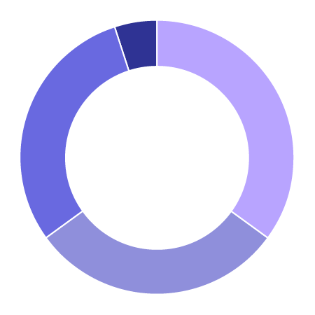
Data Connectors spend 3+ hours per day managing integrations and configuring data connections, and 1-3 hours analyzing data.
Data Connector
Development Style
Top Tools & Technologies
Other
5%
Mostly clicks
35%
HTML/CSS
Javascript
Trad. prog. languages (Java, C#, C/C++, etc.)
Custom objects
Unit tests
Experience
Mostly code
30%
50/50
30%
0-3 years
with Salesforce
3-5 years
with development in general
Previous Role
Salesforce Pros & Cons
+ Ease of use
+ Documentation & training resources
- More trainings & tutorials
- Governor limits
Non-SFDC Dev
45%
Student
23%
Salesforce Use
Biz Analyst
14%
<10-100%
of time spent on Salesforce development
Learning Strategy
Code Samples
Doc
Salesforce Dev Blog
Success Comm
Trailhead
Tutorials
Notes:
Data Connectors are primarily focused on managing integrations and configuring data connections. They are the ones making sure that information is flowing from point A to B to C (through all the various business systems a company might have), with data analysis as a secondary function. Some companies have another position who takes care of the data analysis part.
Data Connectors have a medium amount of development experience that we’ve seen so far, with 3-5 years of experience with development in general.
45% of them also previously were non-Salesforce developers. Some Data Connectors also come from student life and business analyst roles.
In terms of development style, we found a practically even split between using mostly clicks, 50/50 clicks and code, and mostly code with Data Connectors.

Slide 39


I'm developing directly on the platform that my data lives in and my sales users work with. I don't have to worry about the overhead of setting up a full application and server to handle simpler business logic needs.
Chris
Director of Operations
It really is a love-hate relationship I have with making Salesforce suitable for non-IT-minded users, because I have to pick and choose which parts of "sloppy" which I actually want, and which parts I would prefer to be more rigid.
Scott
Senior Salesforce Administrator and Developer
Notes:
Data Connectors like Chris appreciate that they can work directly in the system that their data lives in and that their sales users work with, so they can focus on their business’s data needs.

Slide 40

Meet a Data Connector...
Lewis
An Asset Management Company
Notes:
Here more about the life of a Data Connector from Lewis.

Slide 41
Data Connectors ensure that data flows smoothly between systems, enabling their companies to make better business decisions.
Notes:
Data Connectors ensure that data flows smoothly between systems so their companies can ultimately make better business decisions.

Slide 42
Quality Champion
Test and manage releases
Notes:
Next we’ve got Quality Champions

Slide 43
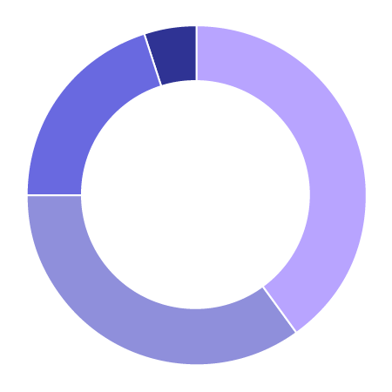
Quality Champions spend 3+ hours per day testing and managing releases, and 1-3 hours writing documentation.
Development Style
Top Tools & Technologies
Quality Champion
Custom objects
Custom page layouts
HTML/CSS
Unit tests
Trad. prog. languages (Java, C#, C/C++, etc.)
Other
5%
Mostly clicks
40%
Mostly code
20%
Experience
50/50
35%
0-3 years
with Salesforce
1-3 years
with development in general
Previous Role
Salesforce Pros & Cons
+ Ease of use & breadth of resources
+ Declarative capabilities
- Governor limits
- Developer tools
Non-SFDC Dev
28%
Student
22%
SFDC User
18%
Salesforce Use
<10-100%
of time spent on Salesforce development
Learning Strategy
Code Samples
Doc
Salesforce Dev Blog
Success Comm
Trailhead
Tutorials
Notes:
Quality Champions spend 3+ hours a day testing and managing releases as their primary job functions. So these are the people who are going in with a fine tooth comb to catch flaws and crosscheck design/development decisions. Their goal is to make sure products go out with the highest quality possible (within reason).
Working towards these goals, we see a shift towards the use of more clicks by Quality Champions - 40% reported that they use mostly clicks, 55% reported 50/50 clicks and code, and 20% reported mostly code.
In their previous lives, Quality Champions come from a bigger variety of roles - 28% were non-Salesforce developers, 22% were students, and 18% were even Salesforce end users.

Slide 44


The ease of use and how most of the requirements can be implemented through point and click, and saves a lot of time and effort both for the developer as well as the client.
Abhishek
Information Technology Analyst
Developing on Salesforce has been a great experience for me but has taken a while for me to adjust to cloud computing. The Visual Studio IDE is very robust and has excellent debug utilities where you can step through code. I wish there was something like this on the Salesforce platform.
Mat
Senior Business Analyst and Developer
Notes:
Although Quality Champions appreciate our point and click capabilities, they do see room for improvement. In the open text portions of the survey, we got a lot of comparisons to Visual Studio like Mat’s comments here essentially wishing we were more like them.

Slide 45


Meet some Quality Champions...
Mark
Appiphony
Svetlana
UCSF
Notes:
Learn what makes Quality Champions like Mark and Svetlana tick!

Slide 46
Quality Champions are focused on the details and detecting flaws before applications go live.

Slide 47
Product Definer
Gather requirements
Notes:
Last but not least: Product Definers!

Slide 48
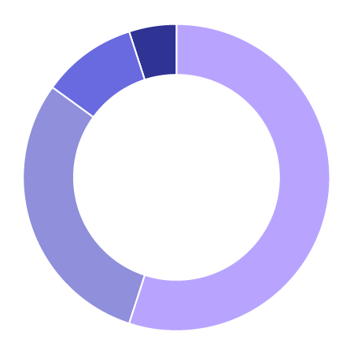
Product Definers spend 3+ hours per day gathering requirements and 1-3 hours writing documentation.
Development Style
Top Tools & Technologies
Product Definer
Custom objects
Custom page layouts
Formulas
Business logic & automation
HTML/CSS
Other
5%
Mostly clicks
55%
Mostly code
10%
Experience
50/50
30%
0-3 years
with Salesforce
0-3 years
with development in general
Previous Role
Salesforce Pros & Cons
+ Ease of use, esp. with declarative tools
+ Documentation & community
- Functionality limitations
- Steep learning curve
Biz Analyst
39%
Non-SFDC Dev
23%
Proj Mgr
20%
Salesforce Use
<10-100%
of time spent on Salesforce development
Learning Strategy
Code Samples
Doc
Salesforce Dev Blog
Success Comm
Trailhead
Tutorials
Notes:
Product Definers are primarily focused on gathering requirements and secondarily on writing documentation. These are the people who mediate that transition between the business and development and act as the translators to suss out what exactly needs to be built.
Not surprisingly, 39% of Product Definers were business analysts in their previous role. 23% were non-Salesforce developers and 20% were project managers.
In terms of development style, Product Definers are less hands-on coding on the Platform with 55% using mostly clicks to do their work, basically the flip of the development style we saw with Core Coders.

Slide 49


It’s intimidating to get started really learning the code behind everything. There’s a big gap between admin skills and development skills, not sure how to make the jump.
Anna
Sales Operations Analyst
The fact that you don't need a computer science degree from MIT to leverage Salesforce. You can configure and get immediate gratification from what you just built. Additionally, you can make modifications quickly to adhere to the business problems and issues so that the business users can focus on what is important (i.e. generating revenue).
Sarah
Salesforce Consultant
Notes:
And the open text responses in our survey reflected this too - as Anna mentions, there is a gap for people to jump into the coding deep end, but thankfully as Sarah mentions, you can still do a lot with the Platform and focus on the business needs.

Slide 50
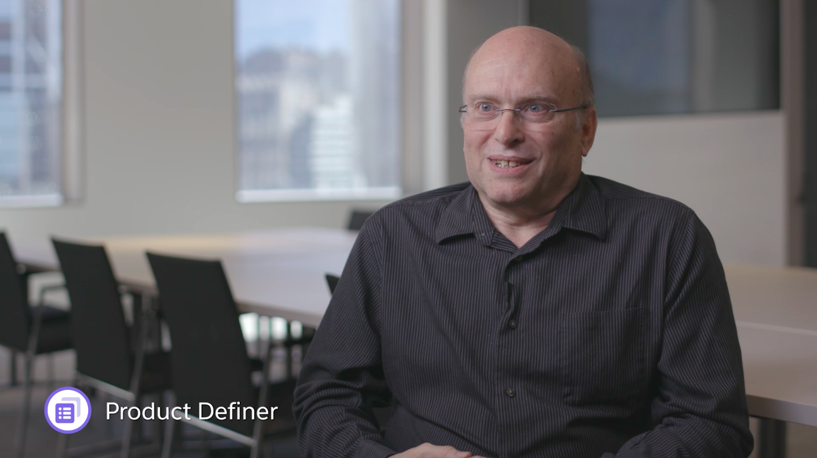
Meet a Product Definer...
Stu
An Asset Management Company
Notes:
Learn more about what it’s like to be a Product Definer from Stu!

Slide 51
Product Definers are the bridge to the business and translate goals into requirements.

Slide 52
How do these personas all fit together?
Notes:
Now that we’ve talked about each Developer Persona, how do they all fit together?

Slide 53
All five personas were found across all company sizes – and in fairly equal proportions.
Notes:
Everyone always asks about company size, so let’s talk about it.
All five personas were found across all company size and in fairly equal proportions.

Slide 54
All five personas were found across all company sizes – and in fairly equal proportions.
Company size had no bearing on developer type.
Core Coder
Cloud Architect
Data Connector
Quality Champion
Product Definer
1-20
21-100
101-500
501-2500
How many total employees does your company / organization have?
2500+
Notes:
As you can see from this chart, all of the darkest purple bars are relatively the same length, this means that about the same number of Core Coders were found at each company size and so on for the other 4 colors of purple representing the other 4 personas.
In other words, company size doesn’t really matter when talking about types of developers.

Slide 55
All the personas were found at all company types too.
Notes:
Additionally, we found that all 5 of the personas were found at all company types too.

Slide 56
All the personas were found at all company types too.
Company type had no bearing on developer type.
Core Coder
Cloud Architect
Data Connector
Quality Champion
Product Definer
Customer
ISV
Student
Consulting Partner
Independent Consultant
Other
Where do you work? Select all that apply.
Notes:
Here’s the chart for company type. As you can see, all the personas were appear with every type of company. Furthermore, while there are small spikes within ISVs and Consulting Partners, the bars within each type of company are fairly balanced, which similar to company size, means that company type had no bearing on type of developer.

Slide 57
Within each persona, few respondents were previously Salesforce administrators.
Notes:
As we alluded to earlier, few respondents within each persona were Salesforce admins in their previous lives.

Slide 58
Few respondents from each persona were previously Salesforce admins.
The jump from admin to developer is limited.
Core Coder
Cloud Architect
Data Connector
Quality Champion
Product Definer
Salesforce Admin
Salesforce User
Non-Salesforce Developer
Student
Business Analyst
Project Manager
Other
What was your previous job role, prior to becoming a Salesforce developer? Select all that apply.
Notes:
Let’s look at the data: Here I’ve highlighted the admin bars in yellow. 13-16% of each persona came from an admin role, while double to triple that number came from developing with other platforms.
In other words, the jump from Salesforce admin to developer is limited.

Slide 59
All the personas use declarative and programmatic tools.
Notes:
Another finding we alluded to is that all the personas use both declarative and programmatic tools

Slide 60
All the personas use both declarative and programmatic tools.
66% of Core Coders use declarative tools at least half the time.
All clicks
Mostly clicks
50/50 clicks & code
Mostly code
All code
Not sure
Core Coder
Cloud Architect
Data Connector
Quality Champion
Which best describes how you customize or build on the Salesforce platform?
Product Definer
All Clicks
All Code
Notes:
Here’s that chart, it’s a little intense. On this chart, all clicks is in the lighter purple on the left and all code is in the darker purple on the right.

Slide 61
All the personas use both declarative and programmatic tools.
66% of Core Coders use declarative tools at least half the time.
All clicks
Mostly clicks
50/50 clicks & code
Mostly code
All code
Not sure
Core Coder
Cloud Architect
Data Connector
Quality Champion
Which best describes how you customize or build on the Salesforce platform?
Product Definer
All Clicks
All Code
Notes:
As you can see, even with Core Coders, 66% of those respondents reported using declarative tools at least half the time. And it only goes up from there for the other personas.
So declarative tools aren’t just for admins.

Slide 62
Clicks to code spectrum
Clicks
Code
Admins
“Point and click customization. For me, that's the best. I'm not a developer.”
Developers
“We always try to do something declaratively if we can. We trust the Salesforce engineers that implemented the feature to be the most efficient. If we can’t, that’s when we go custom.”

Slide 63
Now what?
Notes:
For today’s presentation, now what?

Slide 64
One Platform for admins and developers
Accidental
Admin
Also
Admin
Adept
Admin
All-Star
Admin
Accelerated
Admin
Core
Coder
Cloud
Architect
Data
Connector
Quality
Champion
Product
Definer
Learn more about our Admin Personas here
Notes:
If we zoom out, think of our Platform user personas as both our Admin and Developer Personas. They’re all customizing and building on the Platform.

Slide 65
One Platform for admins and developers
Hands-on Customizers and Builders
Accidental
Admin
Also
Admin
Adept
Admin
All-Star
Admin
Accelerated
Admin
Core
Coder
Cloud
Architect
Data
Connector
Quality
Champion
Product
Definer
Learn more about our Admin Personas here
Notes:
We’ve got our hands-on customizers and builders who are hands on making the changes with all of our admins plus Core Coders

Slide 66
One Platform for admins and developers
Development Leaders & Facilitators
Accidental
Admin
Also
Admin
Adept
Admin
All-Star
Admin
Accelerated
Admin
Core
Coder
Cloud
Architect
Data
Connector
Quality
Champion
Product
Definer
Learn more about our Admin Personas here
Notes:
And then we’ve got our development leaders and facilitators who contribute to the development process in other ways

Slide 67
Let’s build the right tools for the right users.
Notes:
Knowing all of this, let’s build the right tools for the right users

Slide 68

Identify & align
Who is the target persona for your product?
Notes:
You may have 1-2 primary target personas and 1-2 secondary personas, that’s ok.

Slide 69

End to end experience
Does the product match the target persona’s goals and capabilities? How does it fit into their Salesforce experience overall?

Slide 70
1
2
3
4
Prioritization
What changes need to be implemented to satisfy the target persona?
Notes:
What should be prioritized in your release plan?

Slide 71

User stories
Include the specific target persona when writing user stories, for example “As a Core Coder, I need to…”

Slide 72

Customer engagements
Consider which persona the customers that you typically engage with are and how that affects the perspective and feedback they provide.

Slide 73

Research sessions
Recruit participants of the target persona for generative and evaluative user research studies.

Slide 74

Training & documentation
Base resources on the target persona’s goals and how they learn best.

Slide 75
Learn more about our User Personas

Slide 76
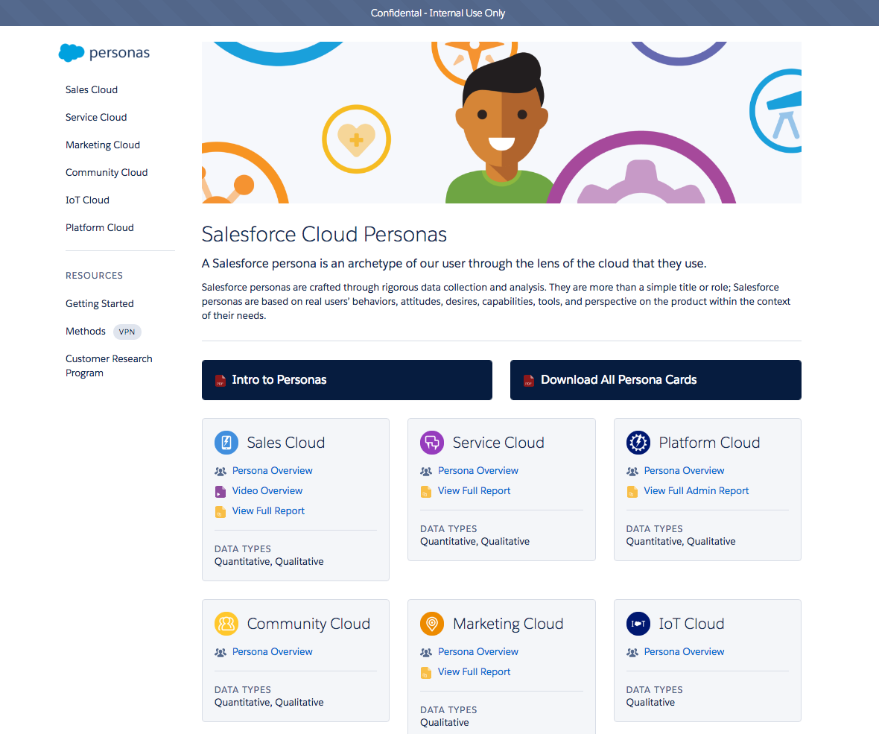
Explore the Persona Website
Sales
Service
Platform
Community
Marketing
IoT
https://sfdc.co/personas

Slide 77
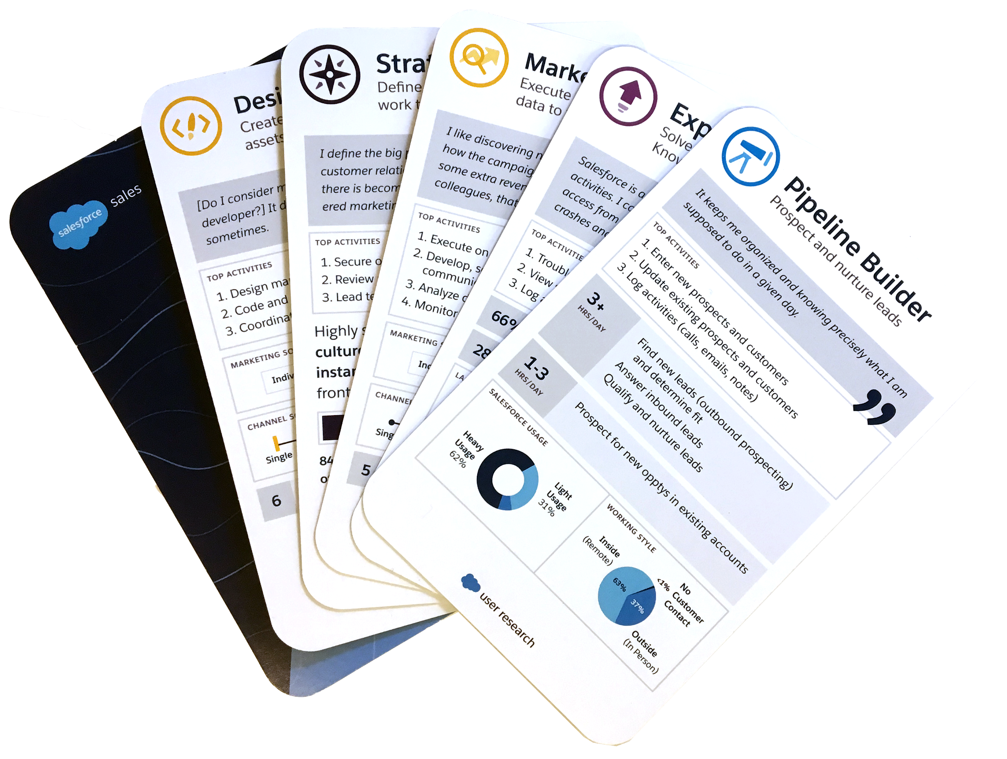

Get a deck of Persona Cards
Post in the Product & User Research Chatter group to get yours!
CONFIDENTIAL

Slide 78




Suggestions?
Let us know how you’d like to use the personas!

Slide 79
Questions?

Slide 80



Ask the user researchers:
Mabel Chan
Senior User Researcher
mabel.chan@salesforce.com
Alyssa Vincent-Hill
Principal User Researcher
avincenthill@salesforce.com
Rebecca Sherrill
Principal User Researcher
rsherrill@salesforce.com

Slide 81
Thanks!

Slide 82



Special thanks to:
Jacob Lehrbaum & Team
Wade Wegner & Team
Noel Lamb
Katey Basye・Jenton Lee・Jason Wang
Everyone who contributed to the survey questions

Slide 83
Appendix

Slide 84
FAQ

Slide 85
FAQ
Why are the Developer Personas based on job function while the Admin Personas are based on skill?
We initially explored segmenting developers by skill too (in fact, we tried three different ways), but clean groupings didn’t emerge.
What skills do each of the Developer Personas have?
Check out these slides.
Where did the list of job functions come from?
Crafting the list of job functions (as well as the rest of the survey) was a collaborative effort that included User Experience, Product Management, and Developer Marketing.
Can we see the Admin Personas by job function?
Stay tuned, we plan to run the admin survey again and include job functions.

Slide 86
FAQ
Are there really that many [insert persona here]?
Yes, the numbers listed here were the result of the factor analysis of respondents’ reported behavior.
What about Heroku and developers who don’t work on Salesforce at all? How do Salesforce (force.com) developers compare?
This study was meant to help us better understand our current Force.com users as a starting point. Exploring the larger market landscape of developers on other platforms would be another interesting piece of the picture and require another large survey effort.
Which code, source control, build, deployment, continuous integration, and testing tools are developers using?
Check out these slides.

Slide 87
FAQ
Are there subgroups within Core Coder?
Maybe, we’re planning to dig into this and will add our findings to this deck.
Can we play around with the survey data ourselves?
We’re working on getting the data into Wave so that individuals can explore on their own. In the meantime, take a look at the full list of survey questions and let us know if there’s something specific you’d like to look at.
Which companies participated in the videos?
We visited development teams at: Appiphony (Chicago, IL), Greystone & Co. (New York, NY), Illinois Institute of Technology (Chicago, IL), Silverline CRM (New York, NY), UCSF Medical Center (San Francisco, CA), and a global asset management company (New York, NY).

Slide 88
Selected Survey Questions

Slide 89
The sample focuses on Force.com developers.
Which parts of the Salesforce platform do you develop on? Select all that apply.
Force.com
86%
Heroku
9%
Lightning Components
30%
S1 Mobile
31%
Thunder
2%
Wave
6%
n = 4740

Slide 90
Large companies were slightly more represented in the sample.
Large companies accounted for 37% of responses, while small companies with 100 employees or fewer accounted for 30% of responses.
1-20
13%
21-100
17%
101-500
16%
501-2500
12%
2500+
37%
I don’t know
4%
n = 4740

Slide 91
The majority of respondents work at customer companies.
Where do you work? Select all that apply.
Customer
61%
Consulting Partner (SI)
38%
ISV Partner
18%
Independent Consultant
9%
Student
7%
Other
4%
n = 4740

Slide 92
The vast majority of respondents are in the United States and India.
In which country are you located? (Top five countries shown below.)
56%
58%
54%
50%
42%
37%
30%
27%
21%
20%
1%
2%
1%
2%
0%
1%
1%
1%
1%
1%
0%
1%
2%
1%
2%
Core Coder
Cloud Architect
Data Connector
Quality Champion
Product Definer
United States
India
Canada
Philippines
United Kingdom

Slide 93





Technology experience matrix
Apex
Business Logic & Automation
Continuous Integration
Custom Objects
Custom Page Layouts
Formulas
HTML/CSS
Integrations with APIs
Javascript
Lightning App Builder
At least 70% successfully use
40-70% successfully use
Less than 40% successfully use
How much experience have you personally had with the following?
Core Coder
Cloud Architect
Data Connector
Quality Champion
Product Definer

Slide 94
Technology experience matrix
At least 70% successfully use
Lightning Components
Lightning Design System
Mobile SDK
Salesforce1 Mobile Platform
Scripting Language (Ruby, PHP, Python, etc.)
Source Control Tools
Trad. Prog. Languages (Java, C#, C/C++, etc)
Unit Tests
Visualforce
40-70% successfully use
Less than 40% successfully use
How much experience have you personally had with the following?
Core Coder
Cloud Architect
Data Connector
Quality Champion
Product Definer

Slide 95
The top 3 languages used are Javascript, SQL (or SQL Server), and Java.
Which of the following languages do you use? Select all that apply.
 | Core Coder | Cloud Architect | Data Connector | Quality Champion | Product Definer | Total
Javascript | 72% | 56% | 54% | 43% | 33% | 58%
SQL (or SQL Server) | 52% | 48% | 52% | 40% | 32% | 47%
Java | 52% | 38% | 40% | 40% | 24% | 42%
C# | 21% | 23% | 22% | 16% | 11% | 20%
PHP | 15% | 18% | 18% | 16% | 12% | 15%
Python | 8% | 12% | 13% | 11% | 10% | 10%
C++ | 19% | 14% | 16% | 14% | 11% | 16%
C | 18% | 11% | 13% | 14% | 8% | 14%
Node.js | 15% | 18% | 15% | 11% | 9% | 14%
AngularJS | 30% | 25% | 22% | 20% | 13% | 24%
Ruby | 4% | 4% | 7% | 8% | 3% | 5%
Objective-C | 5% | 6% | 6% | 2% | 4% | 5%

Slide 96
The most commonly used coding tools are Eclipse, the Developer Console, and the Force.com IDE plug-in for Eclipse.
What tools are your using to code with? Select all that apply.*
Eclipse
52%
Developer Console
52%
Force.com IDE plug-in for Eclipse
45%
Sublime
25%
Visual Studio
20%
* Top eight tools shown here. Other options included: IntelliJ, Aside.io, Other, vim/vi, Cloud9, Emacs, CodeEnvy.
MavensMate
19%
Chrome DevTools
16%
Atom
7%

Slide 97
The most preferred source code control system is Git.
Which source code control system(s) do you prefer to use? Select all that apply.
Git
40%
SVN
22%
TFS
9%
CVS
8%
None
4%
Perforce
3%
Other
1%

Slide 98
The most commonly used build tool is the Salesforce Ant Deployment Tool. However, 27% of developers don’t use any of the tools listed.
What build tools do you use with Salesforce projects? Select all that apply.
SFDC Ant Deployment Tool
41%
None
27%
Maven
21%
Gradle
5%
Other
3%
Cumulus CI
2%

Slide 99
The most commonly used deployment tool is the Force.com IDE.
What do you use to help with deployment? Select all that apply.
Force.com IDE
54%
Workbench
33%
Change Sets
28%
None
16%
Other
5%
Autorabit
2%
Copado
2%
Gearset
2%

Slide 100
The most commonly used continuous integration tool is Jenkins. However, about the same proportion of developers doesn’t use any of the tools listed.
What tools do you use for continuous integration? Select all that apply.
Jenkins
22%
None
21%
Bamboo
8%
TeamCity
4%
Other
3%
CircleCI
3%
TravisCI
2%

Slide 101
The most commonly used testing tools are SoapUI, Selenium, and JUnit/Java. However, slightly more developers don’t use any of the tools listed.
What tools do you use for testing? Select all that apply.*
None
26%
SoapUI
23%
Selenium
20%
JUnit/Java
19%
Javascript Testing Framework
12%
* Top eight tools shown here. Other options included: Other, Karma, RSpec/Ruby, Runscope, Charles, ProxyBurp.
Fiddler
11%
JMeter Performance Tests
5%
Gulp
4%

Slide 102
Top phrases used in open text responses
 | What do you like most about developing on Salesforce? | What do you dislike or would change about developing on Salesforce?
Top Unigrams | Easy (901) Platform (338) Code (281) Development (267) Learn (235) | Limits (268) Lightning (182) Apex (169) IDE (131) Components (111)
Top Bigrams | I/you/we can (191) User friendly (119) User interface (22) Developer Console (19) VF pages (18) | Developer Console (126) Governor limits (125) Lightning Components (49) Visual Studio (35) Version control (32)
Top Trigrams | Point and click (170) Can be done (35) Visualforce pages (19) Apex and Visualforce (14) Similar to Java (12) | Point and click (20) Look and feel (10) Apex and Visualforce (9)
Special thanks to Kris Chant for this analysis!

Slide 103
About ⅓ of developers have a formal education in Computer Science or related field.
Which best describes your educational background, in terms of development? Select all that apply.
Self-Taught
55%
On-the-Job Training
50%
Some College Coursework
22%
Bachelor’s Degree
34%
Post Grad Degree
22%
Industry Certification
15%
Intensive
5%
n = 4740

Slide 104
About 30% of developers have the basic admin and Force.com certifications. Few are certified beyond that.
What types of Salesforce certification have you received? Select all that apply.
Admin
28%
Adv Admin
5%
Force.com Developer
32%
Force.com Adv Developer
4%
Technical Architect
1%
Sales Consultant
8%
Service Consultant
6%
n = 4740

Slide 105
66% of developers work with other developers at least some of the time.
As a developer, which best describes the way you work?
Alone
14%
With others, but I am the only developer
13%
With other developers ad hoc
26%
With other developers on a centralized, shared code base
40%
Other
3%
n = 4740

Slide 106
75% of developers develop on Windows.
What operating system do you primarily develop on?
Windows 10
27%
Windows 7
43%
Other Windows
4%
Mac OS
16%
Linux
3%
Other
2%
n = 4740

Slide 107
Developers primarily use Chrome for their development activities.
What is the primary browser you use to look at, edit, or manage code and other development-related activities?
Chrome
77%
Firefox
9%
Internet Explorer/Edge
5%
Safari
2%
Other
1%
n = 4740

Slide 108
Developers primarily develop for laptops/desktops.
Which devices are you developing for? Select all that apply.
IoT
5%
Laptop/Desktop
91%
Phone
42%
Tablet
36%
Watch
2%
Other
1%
n = 4740

Slide 109
Full Survey Questions

Slide 110
About You
What most closely resembles your job title?
In which country are you located?
How old are you?
What is your gender?
How many total employees does your company have?
Where do you work? Select all that apply.
See full survey content including answer options for each question here

Slide 111
Salesforce Development
About what percentage of your time do you spend on Salesforce development related duties? Consider any activities that help you develop on Salesforce, like requirements gathering and meetings, not just time writing code or logged in to customize Salesforce.
(If 100%) About what percentage of your time do you spend on non-Salesforce development related duties?
Which best describes how you customize or build on the Salesforce platform?
What are your responsibilities as a Salesforce developer? Select all that apply.
What was your previous job role, prior to becoming a Salesforce developer?
Overall, how satisfied do you feel with developing on the Salesforce platform?
On an average day, how much time do you spend doing the following?
See full survey content including answer options for each question here

Slide 112
Salesforce Development continued
Which parts of the Salesforce platform do you develop on? Select all that apply.
Which Salesforce products do you develop on? Select all that apply.
How much experience have you personally had with the following Salesforce technologies?
How much experience have you personally had with the following?
(If successfully used Javascript) Which javascript framework(s) do you currently use, if any? Select all that apply.
(If successfully used Apex or Visualforce) In the course of a project, which of the following do you do using Apex and/or Visualforce? Select all that apply.
(If haven’t attempted to use Lightning Components) What prevents you from using Lightning Components? Select all that apply.
See full survey content including answer options for each question here

Slide 113
Your Development Background
How much experience have you personally had with the following Salesforce technologies?
How long have you been a developer in general?
Which best describes your education background, in terms of development? Select all that apply.
What's most important to you as a developer? Select up to 3.
(If some programmatic) Do you code in your spare time?
As a developer, which best describes the way you work?
See full survey content including answer options for each question here

Slide 114
Salesforce Education and Training
How long have you been developing on or customizing Salesforce?
What types of Salesforce certification have you received? Select all that apply.
How do you update your Salesforce knowledge and learn new skills? Select all that apply.
What is the most effective learning format for you? Select up to 2.
See full survey content including answer options for each question here

Slide 115
Developing for Salesforce
How long have you been developing on or customizing Salesforce?
Why did you start developing on the Salesforce platform? Select all that apply.
Who is the target audience of what you are building? Select all that apply.
What prevents you from using Salesforce for more development projects? Select all that apply.
See full survey content including answer options for each question here

Slide 116
Devices and Platforms
Which devices are you developing for? Select all that apply.
What operating system do you primarily develop on?
What is the primary browser you use to look at, edit, or manage code and other development-related activities?
What other platforms have you used professionally? Select all that apply.If you have a preference for certain platforms, please indicate it in the "prefer it" column.
See full survey content including answer options for each question here

Slide 117
Tools for Development
(If successfully used traditional programming or scripting languages) Which of the following languages do you use? Select all that apply.
(If some programmatic) What tools are you using to code with? Select all that apply.
(If at least played around with source control tools) Which source code control system(s) do you prefer to use?
What build tools do you use with Salesforce projects? Select all that apply.
What do you use to help with deployment? Select all that apply.
(If at least played around with continuous integration) What tools do you use for Continuous Integration? Select all that apply.
What tools do you use for testing? Select all that apply.
See full survey content including answer options for each question here

Slide 118
Lightning Components
How are you using Lightning Components?
What are the biggest barriers to developing Lightning Components? Select all that apply.
Where would you like to use Lightning Components? Select all that apply.
See full survey content including answer options for each question here

Slide 119
Managed Packages
Do you use managed packages functionality?
(If yes) What are your key pain points related to developing a managed package?
Which of the following do you currently use? Select all that apply.
What is the most difficult aspect of releasing an app on the AppExchange?
See full survey content including answer options for each question here

Slide 120
Mobile
Which technologies do you currently develop for? Select all that apply.
(If at least played around with Mobile SDK) What do you think of the Salesforce Mobile SDK?
How easy or difficult is it to build on the Salesforce Mobile SDK?
What is missing from the SDK?
See full survey content including answer options for each question here

Slide 121
Lightning Design System
Which parts of the Lightning Design system do you use? Select all that apply.
Which platform(s) have you developed on using SLDS? Select all that apply.
See full survey content including answer options for each question here

Slide 122
Heroku
How do you integrate Heroku apps with Salesforce? Select all that apply.
Which tools do you use for continuous integration with Heroku? Select all that apply.
Have you managed more than one resource (add on) in an Heroku app?
See full survey content including answer options for each question here

Slide 123
Closing
What do you like most about developing on Salesforce?
What do you dislike or would like to change about developing on Salesforce?
Would you be interested in participating in future research opportunities to provide feedback to the Salesforce User Experience team?
If you would like to enter the sweepstakes for a gift certificate, please provide your contact information:
See full survey content including answer options for each question here

